Slide 1
Multiple Inheritance

Slide 2
Outline
Multiple Inheritance in Java
The Diamond Problem
Interfaces

Slide 3



Multiple Inheritance
Multiple Inheritance is a feature in object orient programming where a child class can inherit properties of more than one parent class.

Slide 4
Multiple Inheritance
Unlike other popular object-oriented programming languages such as C++, java does not provide support for multiple inheritance for classes.

Slide 5
interface
Father
{
}
interface
Mother
{
}
public class
Daughter implements Father, Mother
{
}

Slide 6
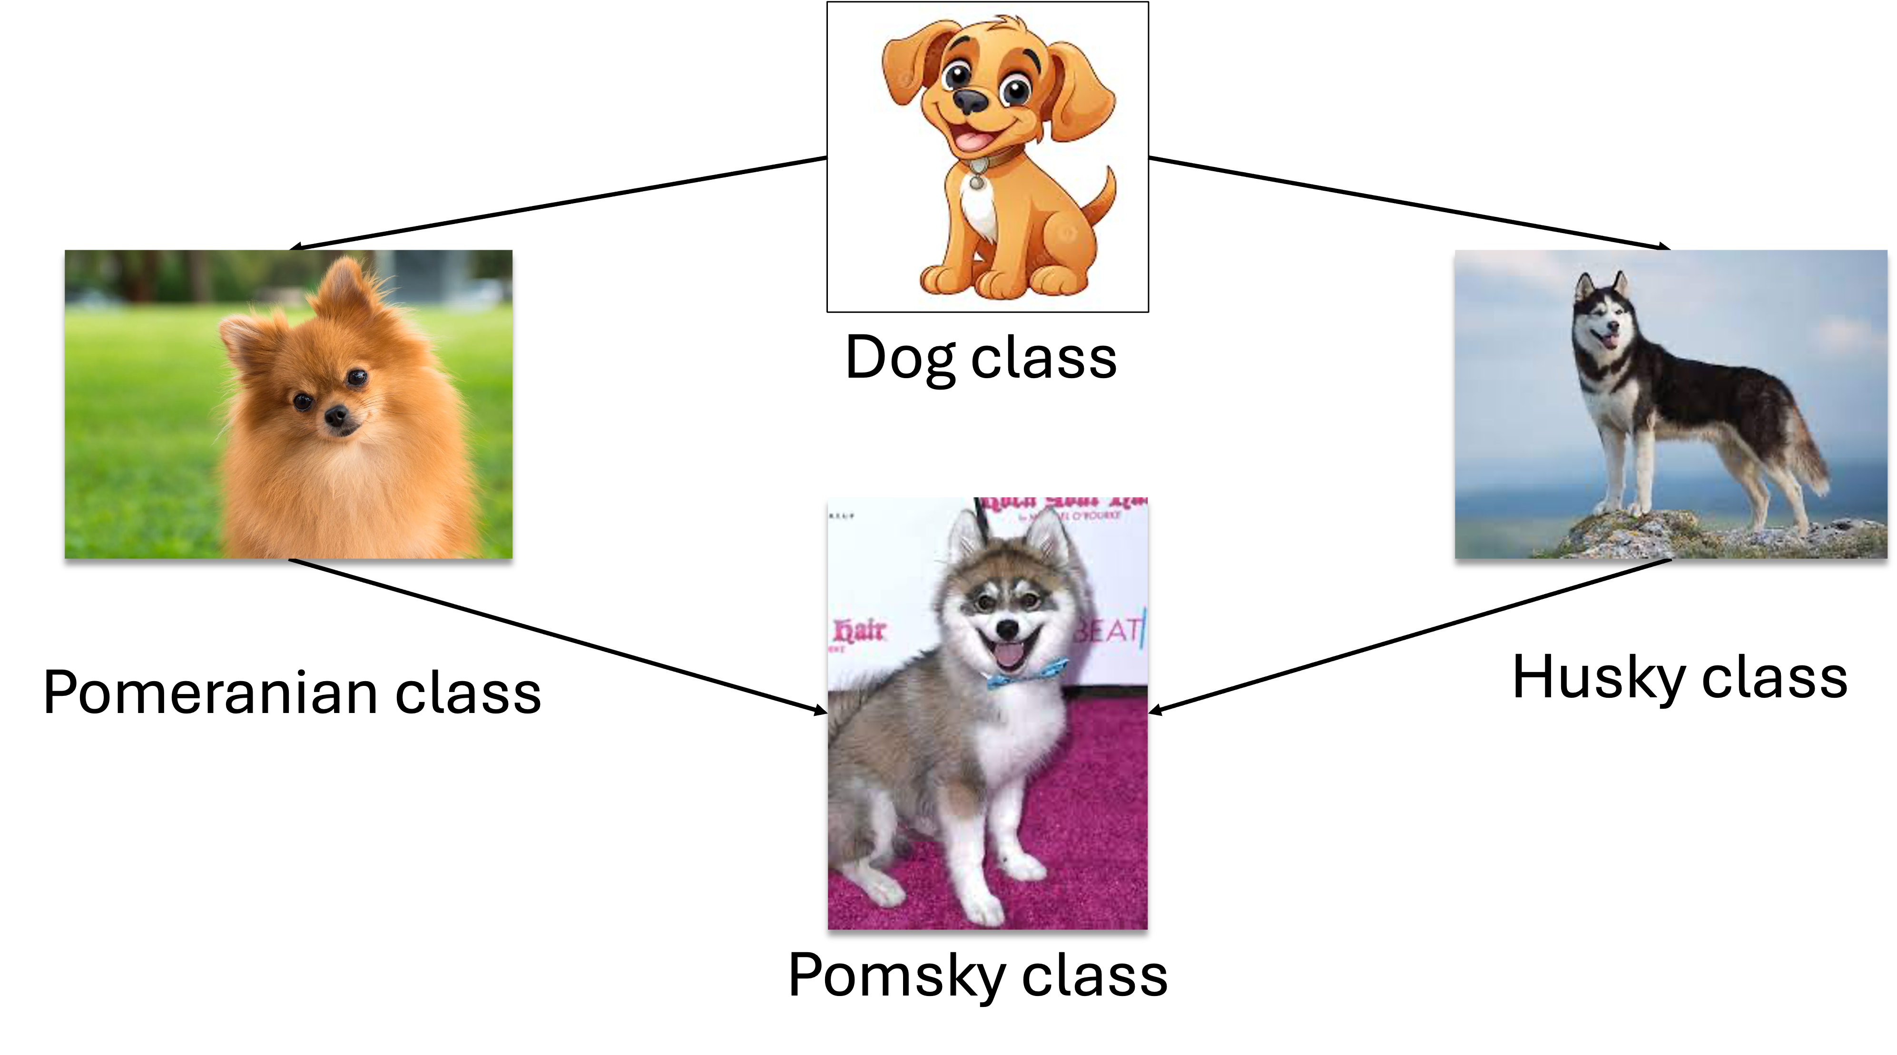
The Diamond Problem
Java does not support multiple inheritance in classes because it can lead to the diamond problem.

Slide 7
The Diamond Problem
The diamond problem is a situation where the compiler does not know exactly which class method to execute if that class method is defined in the parent class and its child classes.

Slide 8




Dog class
Pomeranian class
Husky class
Pomsky class

Slide 9
class Dog
bark()
class Pomeranian
bark()
class Husky
bark()
The bark() method is ambiguous because java does not know which bark() method to execute.
class Pomsky

Slide 10
public class
Dog
{
public void bark();
}
public class
{
Pomeranian extends Dog
public void bark() {“Pomeranian is barking“;}
}
public class
Husky extends Dog
{
public void bark() {“Husky is barking“;}
}

Slide 11
public class
Pomsky extends Pomeranian, Husky
{
}
{
public class App
public static void
main
(String[] args)
{
Pomsky mypomsky = new Pomsky();
mypomsky.bark();
Which bark() method are you referring to ???
}
}

Slide 12
public class
Pomsky extends Pomeranian, Husky
{
}
{
public class App
public static void
main
(String[] args)
{
Pomsky mypomsky = new Pomsky();
mypomsky.bark();
Java does not support multiple inheritance in classes to avoid all the complexity
and to keep things simple and straightforward.
}
}

Slide 13

class Dog
bark()
class Pomeranian
bark()
class Husky
bark()
class Pomsky

Slide 14
Outline
Multiple Inheritance in Java
The Diamond Problem
Interfaces

Slide 15
Interface
Multiple Inheritance is supported in java through interfaces.
There will be no ambiguity because interfaces only declare methods and the actual implementation will be done by concrete classes implementing the interfaces.

Slide 16
Interface
A single interface can extend multiple interfaces.
A single class can implement multiple interfaces.

Slide 17
interface Dog
int height, String eyecolor
bark()
interface Pomeranian
int height = 15
interface Husky
String eyeColor = “blue”
interface Pomsky
bark()
class Pet
Concrete class to implement the Pomsky interface

Slide 18
interface Dog
int height, String eyecolor
bark()
Dog
interface
{
public void bark();
Int height;
String eyecolor;
interface Pomeranian
int height = 15
interface Husky
String eyeColor = “blue”
}
interface
Pomeranian extends Dog
{
Int height = 15;
}
interface
Husky extends Dog
{
String eyecolor = ”Blue”;
}

Slide 19
interface Dog
int height, String eyecolor
bark()
interface
Pomsky extends Pomeranian, Husky
{
}
public class
Pet extends Pomsky
{
interface Pomeranian
int height = 15
interface Husky
String eyeColor = “blue”
public void bark() {“My Pomsky is barking“;}
}
interface Pomsky
bark()
class Pet

